Slide 1

Zippy Forms
Brad Sandorf, Alex Tuttle, Vincent Garbonick

Slide 2
What is Zippy Forms?
Zippy Forms allows users to easily create their own forms using a drag and drop editor.
Users can host the forms they create using Zippy Forms on their own content management system and choose the database to record the values submitted by the forms.

Slide 3
System Design
User creates form with drag and drop editor
HTML, PHP, and SQL files are created from the information that the user provides
Users can then upload the webapps to their CMS of choice
Form data will be recorded to their database

Slide 4
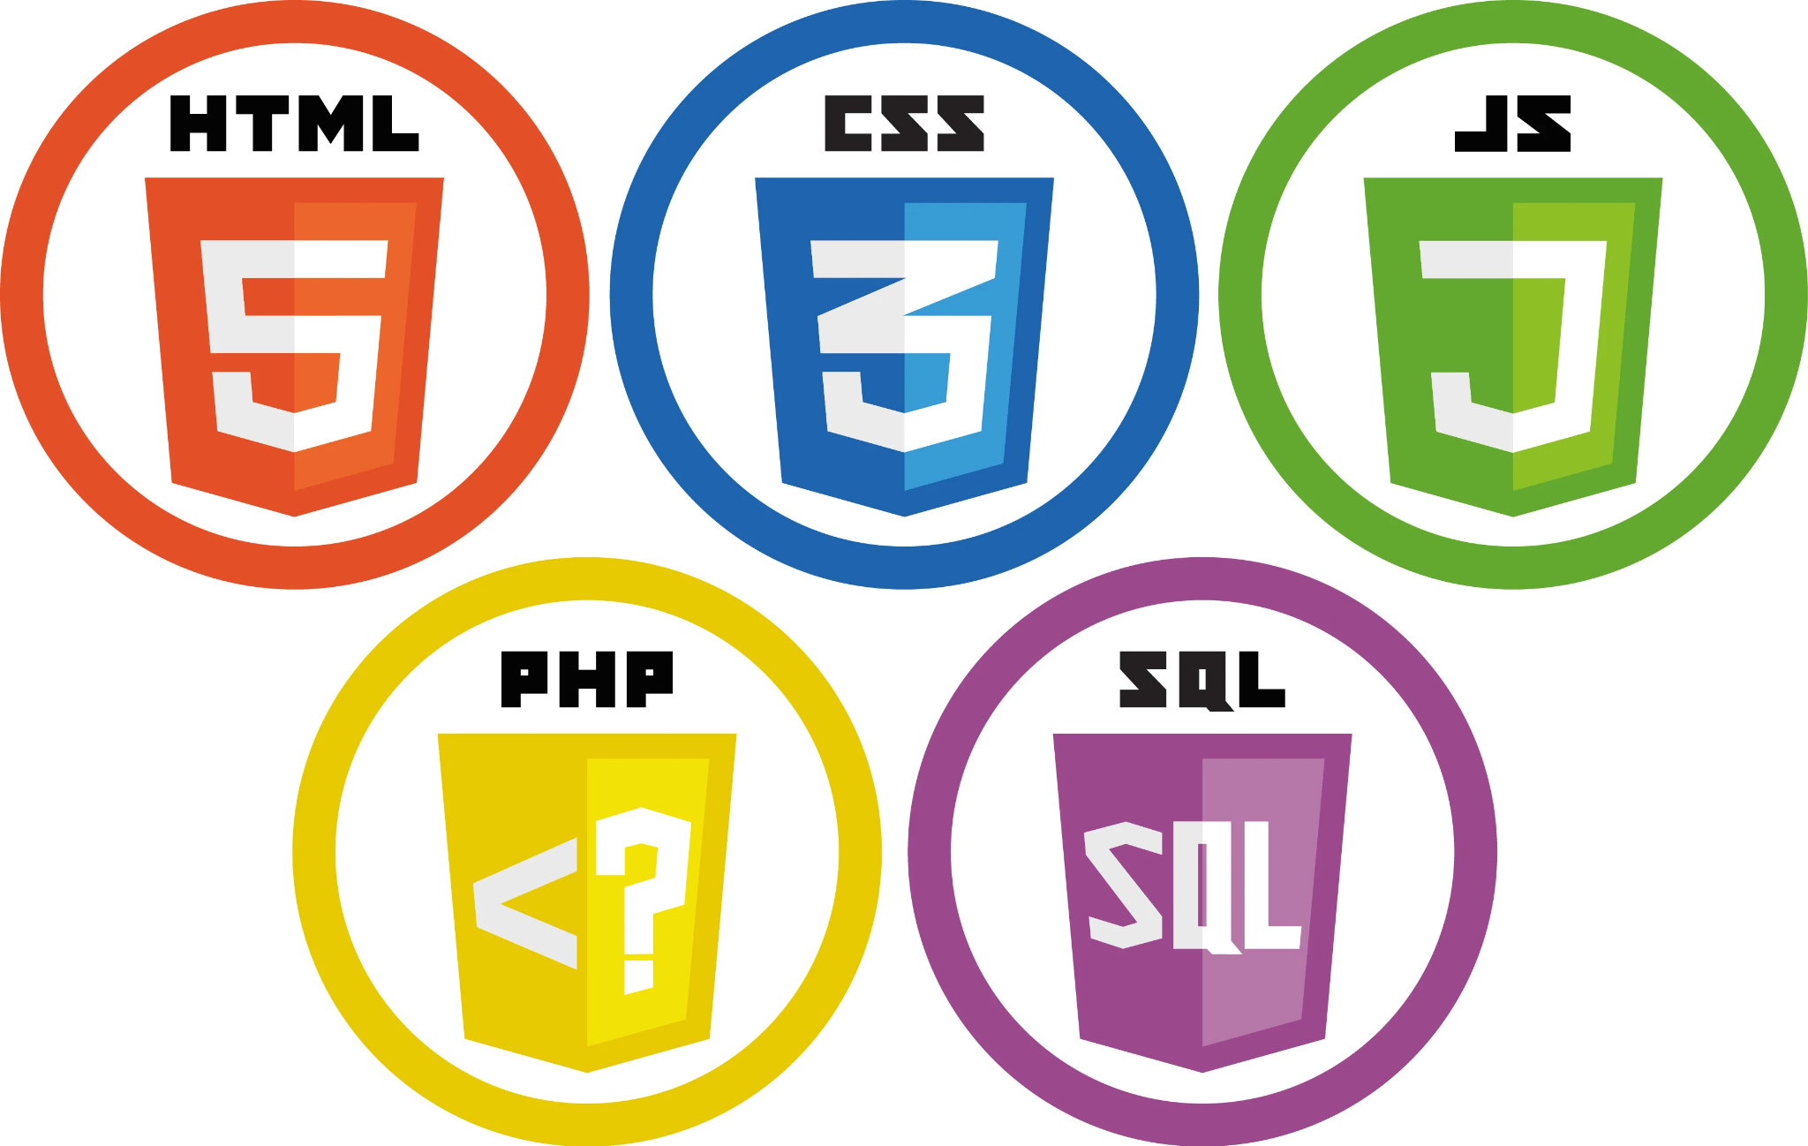
Implementation Tools

Slide 5

Issues
Creating database tables based on the forms created by the generator to hold the user answers in the database
Needing to learn a new codebase and build onto it

Slide 6

Conclusion
Zippy Forms is a great tool for individuals with minimal knowledge of programming or web development to create forms that they can host on the CMS of their choice with an easy to use drag and drop interface

